Slide 1


SOLAR AND WIND POWERED HYBRID ENERGY VEHICLE
Presented By :
P. Dinesh Kumar - (510920106005)
M. Pavithra - (510920106012)
S. Rithika - (510920106018)
V. Tamilarasan - (510920106306)
B.E. ELECTRONICS AND COMMUNICATION ENGINEERING
Guided By:
Dr . S. Chandru M.E., Ph.D.
Assistant Professor/HOD
Department of ECE

Slide 2
OVERVIEW
OBJECTIVE
ABSTRACT
LITERATURE SURVEY
EXISTING SYSTEM
PROPOSED SYSTEM
COMPONENTS REQUIREMENTS
RESULT AND ANALYSIS
OUTPUT
CIRCUIT DIAGRAM
PROPOSED SYSTEM ADVANTAGES
CONCLUSION
FUTURE CONSIDERATION
REFERENCE
QUERIES

Slide 3
OBJECTIVE
Optimize Renewable Energy Utilization:
Maximize the utilization of solar and wind energy resources to ensure efficient and sustainable power generation for electric vehicle charging.
Enhance Energy Storage and Management:
Develop an advanced energy storage and management system to store excess energy during peak production periods and efficiently distribute it during periods of low renewable energy output.
Integrate Smart Charging Technologies:
Implement smart charging algorithms and technologies to prioritize the use of renewable energy sources when available, optimizing the charging process for electric vehicles.

Slide 4
ABSTRACT
Energy crisis and pollution caused by vehicle emissions are one of the most important issues in the present society. Due to the charging time of battery of electric vehicle, requirement of charging on board is explored as option. This paper deals with the design of a hybrid model of a solar and wind, which uses the battery as its storage system. This system allows the two sources to supply the load separately or simultaneously depending on the availability of the energy sources. The power generated from the wind and solar is fluctuating in nature. The system obtains maximum solar energy during day time and maximum wind energy during the night because the wind blows more at night compared to day time. Therefore battery of the vehicle can be charged by using hybrid energy system.

Slide 5
LITERATURE SURVEY
SI.NO | TITLE | JOURNAL NAME | AUTHOR | YEAR OF PUBLICATION | TECHNIQUES USED | DRAWBACKS
1 | Design and Analysis of a Solar-Wind Hybrid Energy System for Vehicle Power Generation. | IEEE Jordan Conference on Applied Electrical Engineering and Computing Technologies (AEECT) | F. Yildiz, M. Korkmaz | 2022 | Techniques such as solar irradiance measurement, wind speed analysis, and historical weather data analysis are used to understand the availability and variability of these resources. | Both wind and solar energy are subject to fluctuations in availability based on weather conditions. Integrating multiple renewable energy sources into a hybrid system adds complexity to the design and maintenance of the vehicle's power generation system.
2 | A Review of Solar and Wind Powered Electric Vehicle Charging Systems. | IEEE Transactions on Instrumentation and Measurement | S. S.Pathak, S.S.Singh, and B.Singh | 2022 | Techniques such as performance modeling, simulation, and field testing are used to evaluate the performance of solar and wind-powered EV charging systems. | Urban areas often have limited space available for installing solar panels and wind turbines at the scale required to meet the demand for EV charging. Solar panels and wind turbines require significant space for installation, which may be limited in urban environments or on vehicles.

Slide 6
SI.NO | TITLE | JOURNAL NAME | AUTHOR | YEAR OF PUBLICATION | TECHNIQUES USED | DRAWBACKS
3. | Optimized generated power of a solar PV system using an intelligent tracking technique. | International Journal of Power Electronics and Drive Systems (IJPEDS) | A. T. Balal, M. Abedi, and F. Shahabi | 2021 | Deploy sensors, such as light sensors to measure solar irradiance levels and environmental conditions. Use data acquisition systems to collect real-time data from the PV system, including voltage, current, and temperature measurements. | Depending on local regulations and permitting requirements, the installation of solar PV systems with intelligent tracking capabilities may face additional approval processes or compliance checks.
4. | Innovative design method and experimental investigation of a small-scale and very low tip-speed ratio wind turbine. | IEEE 2nd International Conference on Advance Computing and Innovative Technologies in Engineering (ICACITE) | M. Bourhis, M. Pereira, F. Ravelet, and I. Dobrev. | 2021 | Employ design thinking principles to understand user needs, define design challenges, brainstorm innovative solutions, and iterate through prototyping and testing cycles. | Small horizontal axis wind turbines operating at low wind speeds often face challenges in achieving high performance compared to large wind turbines.

Slide 7
SI.NO | TITLE | JOURNAL NAME | AUTHOR | YEAR OF PUBLICATION | TECHNQUES USED | DRAWBACKS
5. | Design and Analysis of a Solar-Wind Powered Electric Vehicle Charging Station. | IEEE International Conference on Data Science & Communication (IconDSC) | S. H. Lee and S. S. Kim | 2021 | Conduct a detailed assessment of solar and wind resources at the location of the charging station. Techniques such as solar irradiance measurement, wind speed analysis, and historical weather data analysis are used to understand the availability and variability of these resources. | While the paper suggests that the hybrid charging station offers a cost-effective solution for electric vehicle charging, the initial investment required for installing and maintaining the system may be considerable.
6. | Performance Analysis of a Wind-Solar Hybrid Energy System for Electric Vehicle Charging Station. | IEEE Asian Conference on Innovation in Technology (ASIANCON) | T. H. Lee, J. W. Kim, and D. H. Lee | 2021 | Evaluate the solar and wind resources at the location of the charging station. Techniques include solar irradiance measurement, wind speed analysis, and historical weather data analysis. Determine the temporal and spatial variability of solar and wind resources to understand their availability for energy generation. | Integrating multiple renewable energy sources, a battery bank, and a power conditioning unit into the hybrid system increases its complexity. Wind turbines and solar panels require significant space for installation, which may be limited at EV charging station sites, particularly in urban environments.

Slide 8
SI.NO | TITLE | JOURNAL NAME | AUTHOR | YEAR OF PUBLICATION | TECHNIQUES USED | DRAWBACKS
7 | Effects of root Gurney flaps on the aerodynamic performance of a horizontal axis wind turbine | IEEE International Conference on Research in Computational Intelligence and Communication Networks (ICRCICN) | Y. Zhang, V. Ramdoss, Z. Saleem, X. Wang, G. Schepers, and C. Ferreira, | 2019 | Measure the total energy produced by the PV panels and wind turbines hybrid system over a specific period, considering variations in solar irradiance, wind speed, and system efficiency. | Economic evaluation relies on assumptions and projections regarding costs, revenues, and discount rates, which can introduce uncertainty and bias into the analysis. Sensitivity to input parameters and market dynamics may affect the reliability of economic metrics such as ROI and LCOE

Slide 9
EXISTING SYSTEM
Demerits:
Intermittency
High Initial Costs
EV 1
BUCK CONVERTER
BUCK CONVERTER
EV 4
DC BUS(400V)
BUCK CONVERTER
EV 3
EV 2
BUCK CONVERTER
SOLAR FARM
BOOST CONVERTER
THREE PHASE RECTIFIER
WIND TURBINES

Slide 10
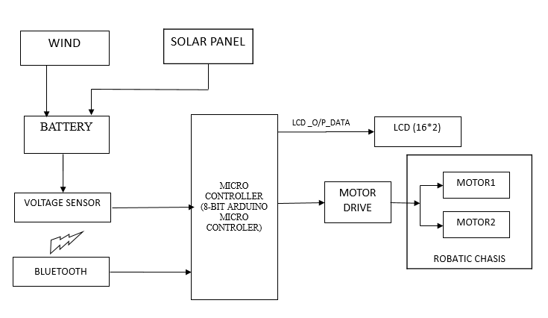
PROPOSED SYSTEM

Slide 11
HARDWARE AND SOFTWARE REQUIREMENTS
HARDWARE REQUIRMENTS
ARDUINO
VOLTAGE SENSOR
MOTORDRIVE
ROBOT CHASIS
BLUETOOTH
LCD
BATTERY
SOLAR PANEL
SOFTWARE REQUIRMENTS
ARDUINO IDE
EMBEDDED C

Slide 12
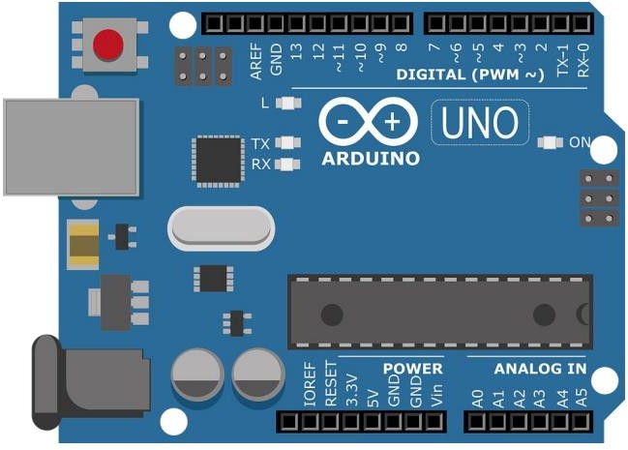
HARDWARES
The Arduino board exposes most of the microcontroller's I/O pins for use by other circuits. The Diecimila, Duemilanove, and current Uno provide 14 digital I/O pins, six of which can produce pulse-width modulated signals, and six analog inputs, which can also be used as six digital I/O pins. These pins are on the top of the board, via female 0.1-inch (2.54 mm) headers. Several plug-in application shields are also commercially available.
ARDUINO UNO
Technical specifications:
Microcontroller ATmega328P Operating Voltage 5V,
Digital I/O Pins 14 (of which 6 provide PWM output),
PWM Digital I/O Pins,
6 Analog Input Pins, 6 DC Current per I/O Pin,
20 mA DC Current for 3.3V,
Pin 50 mA Flash Memory 32 KB (ATmega328P) of which 0.5 KB used by bootloader SRAM 2 KB (ATmega328P),
EEPROM 1 KB (ATmega328P),
Clock Speed 16 MHz,
Length 68.6 mm, Width 53.4 mm and Weight 25 g .

Slide 13
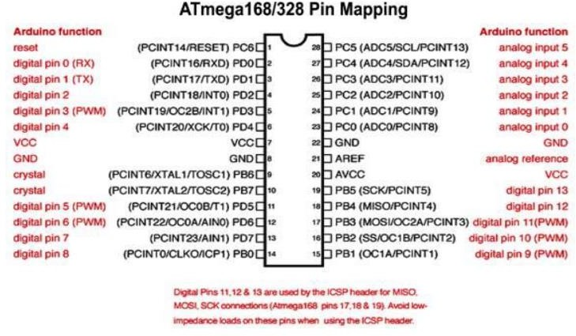

Slide 14
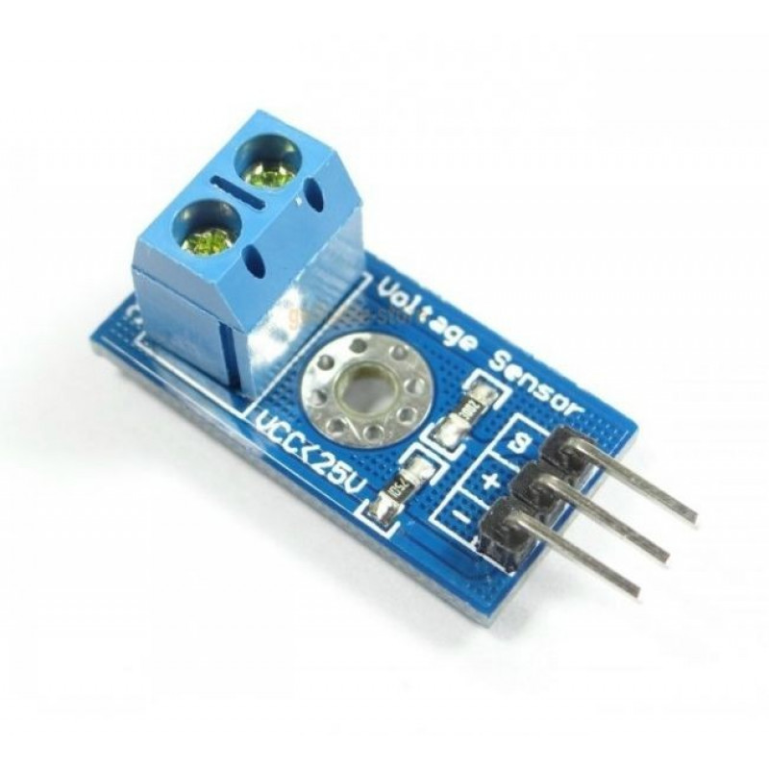
Description:-
Voltage Sensor is a precise low cost sensor for measuring voltage. It is based on principle of resistive voltage divider design. It can make the red terminal connector input voltage to 5 times smaller. Arduino analog input voltages up to 5V, the voltage detection module input voltage not greater than 5Vx5=25V (if using 3.3V systems, input voltage not greater than 3.3Vx5=16.5V).
Features:-
Voltage input range: DC 0-25V
Voltage detection range: DC 0.02445V-25V
Voltage Analog Resolution: 0.00489V
DC input connector: Terminal cathode connected to VCC, GND negative pole
Output interface: "+" connect 5/3.3V, "-" connect GND, "s" connect the Arduino AD pins
VOLTAGE SENSOR

Slide 15
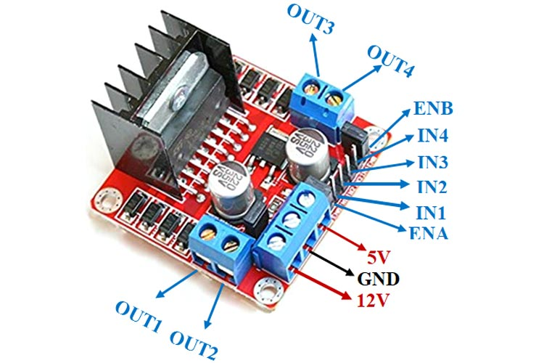
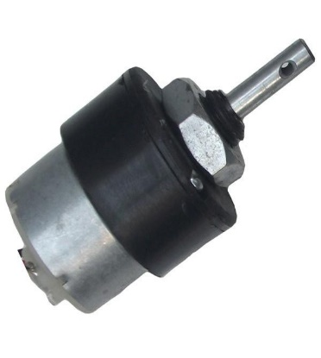
Motor controllers, also known as motor drivers or motor drives, regulate the speed, torque, and direction of the motors based on input commands. These controllers receive signals from the vehicle's control system, usually a microcontroller or a microprocessor, and convert them into appropriate electrical signals to drive the motors.
MOTORDRIVE
FEATURES:
Supply voltage: 12VDC
Speed: 100rpm
Long Lifetime, Low Noise, Smooth Motion
DC gear motor

Slide 16
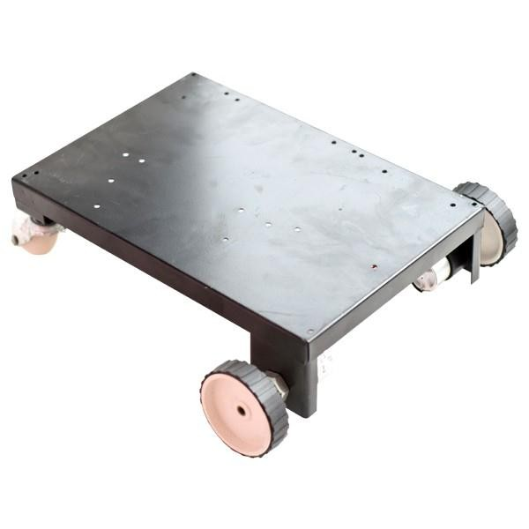
A Vehicle full set robot contains two DC gear motors. The machine consists of minimum mechanical tools resulting in a high quality robot. These motors are directly controlled by two modes. Pulses from micro controller and it can be controlled by means of motordrive. It can be moved to forward direction and reverse direction for detection of the object.
FEATURES:
DC gear motor
Human-Robot Vehicles
High speed
Less noise
Multivehicle Systems
APPLICATIONS:
Industrial products.
Lab automation.
Military and law enforcement.
Recreation and hobby.
ROBOT CHASIS

Slide 17
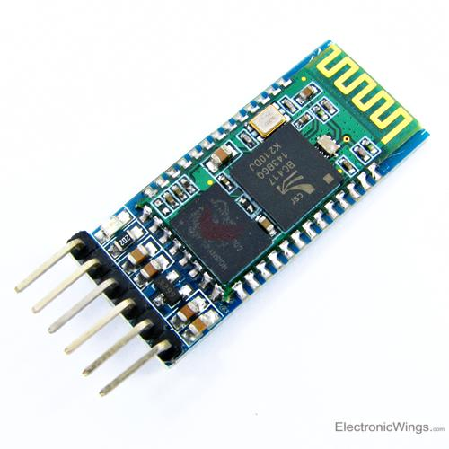
BLUETOOTH
Bluetooth Module HC-05:
It is used for many applications like wireless headset, game controllers, wireless mouse, wireless keyboard, and many more consumer applications.
It has range up to <100m which depends upon transmitter and receiver, atmosphere, geographic & urban conditions.
It is IEEE 802.15.1 standardized protocol, through which one can build wireless Personal Area Network (PAN). It uses frequency-hopping spread spectrum (FHSS) radio technology to send data over air.
It uses serial communication to communicate with devices. It communicates with microcontroller using serial port.

Slide 18
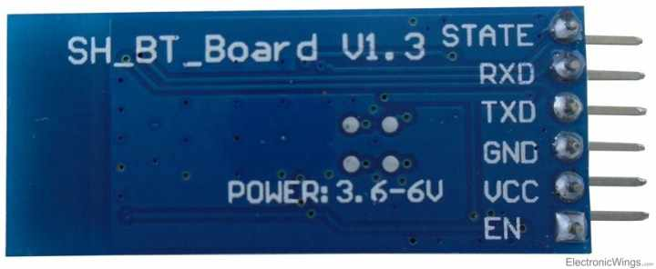
It has 6 pins,
1. Key/EN: It is used to bring Bluetooth module in AT commands mode.
1. Data mode: Exchange of data between devices.
2. Command mode: It uses AT commands which are used to change setting of HC-05. To send these commands to module serial (USART) port is used.
2. VCC: Connect 5 V or 3.3 V to this Pin.
3. GND: Ground Pin of module.
4. TXD: Transmit Serial data (wirelessly received data by Bluetooth module transmitted out serially on TXD pin)
5. RXD: Receive data serially (received data will be transmitted wirelessly by Bluetooth module).
6. State: It tells whether module is connected or not.

Slide 19
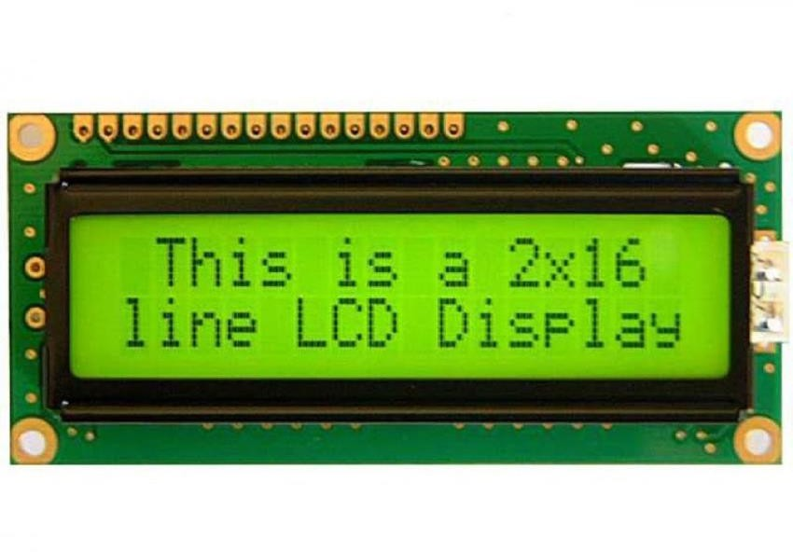
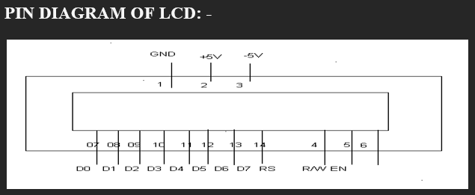
LIQUID CRYSTAL DISPLAY (LCD):
LCD is a type of display used in digital watches and many portable computers. LCD displays utilize to sheets of polarizing material with a liquid crystal solution between them. An electric current passed through the liquid causes the crystals to align so that light cannot pass through them.
PIN DESCRIPTIONS:
Vcc, Vss and Vee:
While Vcc and Vss provide +5V and ground respectively, Vee is used for controlling LCD contrast.
RS Register Select:
If RS=0, the instruction command code register is selected, allowing the user to send a command such as clear display, cursor at home, etc. If RS=1, the data register is selected, allowing the user to send data to be displayed on the LCD.
D0 – D7:
RS = 0 to check the busy flag bit to see if the LCD is ready to receive information. The busy flag is D7 and can be read when R/W=1 and RS=0, as follows: if R/W = 1, RS = 0. When D7= 1 (busy flag = 1), the LCD is busy taking care of internal operations and will not accept any information.

Slide 20
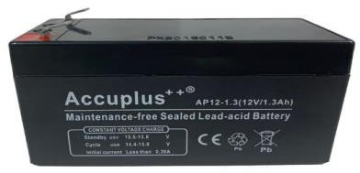
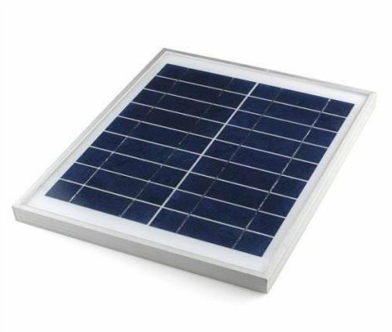
BATTERY:
12V 1.3Ah Rechargeable Lead Acid Battery is normally use for robots in competition. Wired or Wireless Robots runs for a long time with high speed with this type of battery.
Seal Lead Acid (SLA) Rechargeable battery is the most common general purpose
battery.
Low cost, robust and less maintenance required are the advantages of SLA. But it is considered heavy weight for certain robotic application.
Specifications:
Voltage: 12V
Capacity: 1.3Ah
Size: 98mm x 43mm x 52 mm
Weight: 0.450k
SOLAR PANEL:
A solar panel, or photo-voltaic (PV) module, is an assembly of photo-voltaic cells. Solar panels use sunlight as a source of energy and generate direct current electricity.
A collection of PV modules is called a PV panel, and a system of panels is an array. Arrays of a photovoltaic system supply solar electricity to electrical equipment.
This 12V 10Watt Solar Panel is Engineered with high-efficiency polycrystalline silicon solar cells.
Features :
Material : Steel
Panel Wattage: 10Watt
Voltage: 12V
Dimensions: 34x28.5x2mm and Weight: 1.125gm

Slide 21
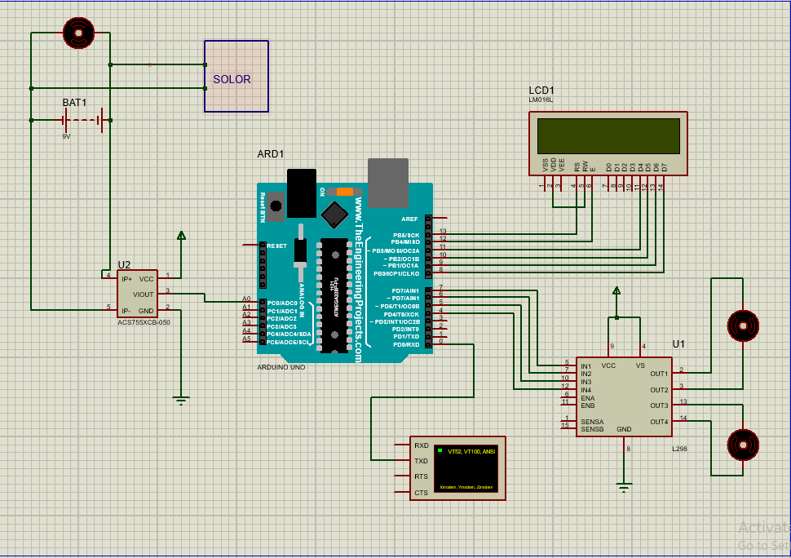
CIRCUIT DIAGRAM

Slide 22
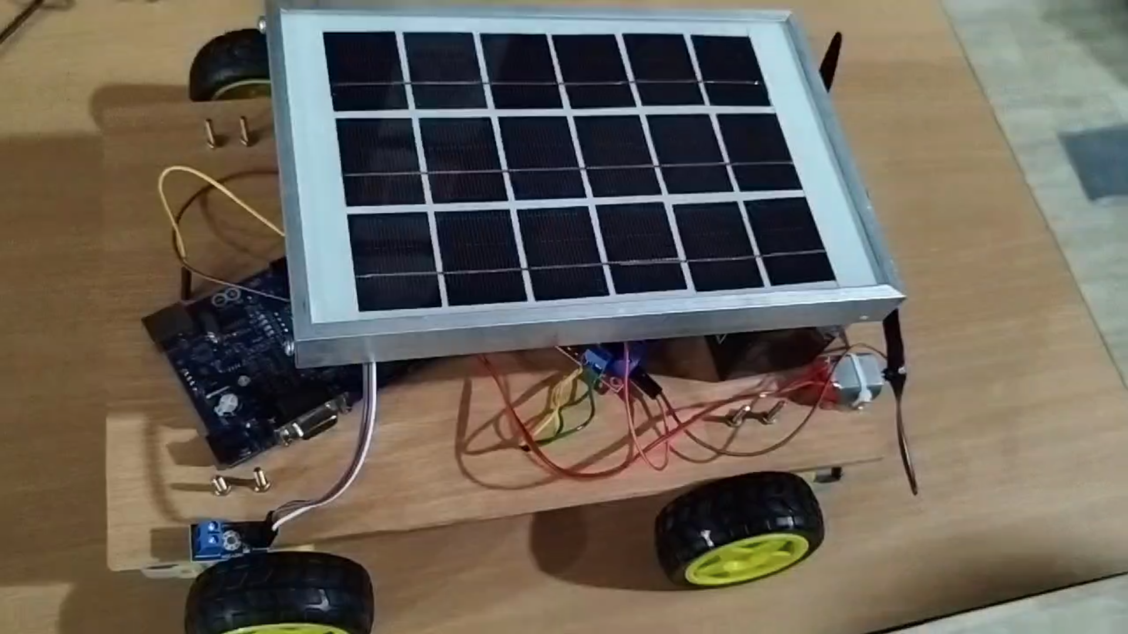
RESULTS AND ANALYSIS
SOLAR PANEL
VOLTAGE
SENSOR
WHEEL

Slide 23
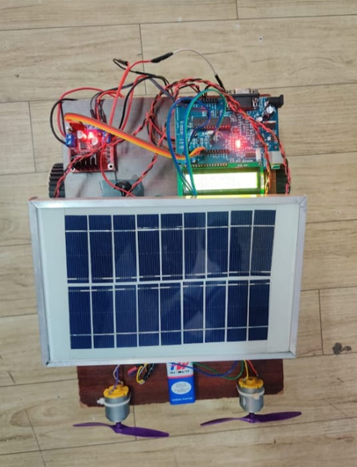
MOTOR
DRIVE
LCD
WIND TURBINE

Slide 24

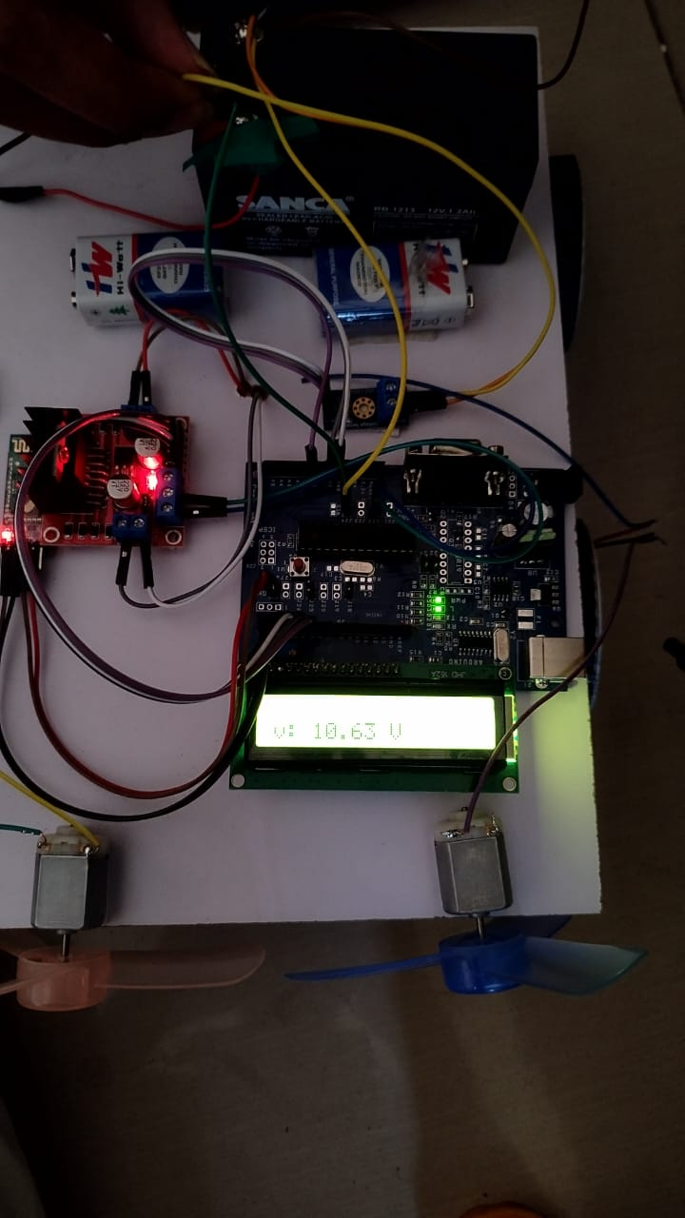
OUTPUT

Slide 25
PROPOSED SYSTEM ADVANTAGES
24/7 Charging Availability: Unlike standalone solar or wind systems, the hybrid model ensures charging availability round the clock by leveraging the complementary nature of solar and wind energy. Solar panels capture energy during the day, while wind turbines generate power at night, ensuring continuous charging capability for electric vehicles.
Flexible Charging Options: The hybrid system offers flexibility in charging options, allowing the vehicle battery to be charged using solar energy, wind energy, or a combination of both, depending on the availability of energy sources. This enhances convenience for vehicle owners and optimizes charging efficiency.
Reduced Environmental Impact: The use of renewable energy sources for vehicle charging helps to reduce air and noise pollution, improving local air quality and public health. By avoiding the combustion of fossil fuels, the hybrid system contributes to mitigating climate change and protecting ecosystems.

Slide 26
CONCLUSION
In conclusion, addressing the energy crisis and pollution from vehicle emissions is paramount in today's society. This paper proposes a solution through the design of a hybrid model utilizing solar and wind energy, with the vehicle battery serving as the storage system. This innovative approach enables the system to tap into both energy sources separately or simultaneously, depending on their availability. Given the fluctuating nature of solar and wind power, the system optimizes energy capture by leveraging solar energy during the day and wind energy during the night, when wind speeds tend to be higher. By integrating this hybrid energy system, vehicle batteries can be efficiently charged, contributing to a sustainable and environmentally friendly transportation solution.

Slide 27
FUTURE CONSIDERATION
Efficiency Optimization: Continued research and development efforts should focus on optimizing the efficiency of the hybrid energy system. This includes improving the energy conversion efficiency of solar panels and wind turbines, as well as enhancing the charging and discharging efficiency of the battery storage system.
Energy Management Strategies: Developing advanced energy management strategies is essential for maximizing the utilization of available energy sources and optimizing system performance. Intelligent algorithms can be implemented to dynamically control the charging process based on real-time energy availability, load demand, and battery state of charge.

Slide 28
REFERENCES
H. S. Das, M. M. Rahman, S. Li, and C. Tan, "Electric vehicles standards, charging infrastructure, and impact on grid integration: A technological review," Renewable and Sustainable Energy Reviews, vol. 120, p. 109618, 2020.
O. Ekren, C. H. Canbaz, and Ç. B. Güvel, "Sizing of a solar-wind hybrid electric vehicle charging station by using HOMER software," Journal of Cleaner Production, vol. 279, p. 123615, 2021.
M. S. H. Lipu et al., "Review of electric vehicle converter configurations, control schemes and optimizations: Challenges and suggestions," Electronics, vol. 10, no. 4, p. 477, 2021.
G. Kumar, "Optimal power point tracking of solar and wind energy in a hybrid wind solar energy system," International Journal of Energy and Environmental Engineering, vol. 13, no. 1, pp. 77-103, 2022.
V. Khare, S. Nema, and P. Baredar, "Solar–wind hybrid renewable energy system: A review," Renewable and Sustainable Energy Reviews, vol. 58, pp. 23-33, 2016

Slide 29
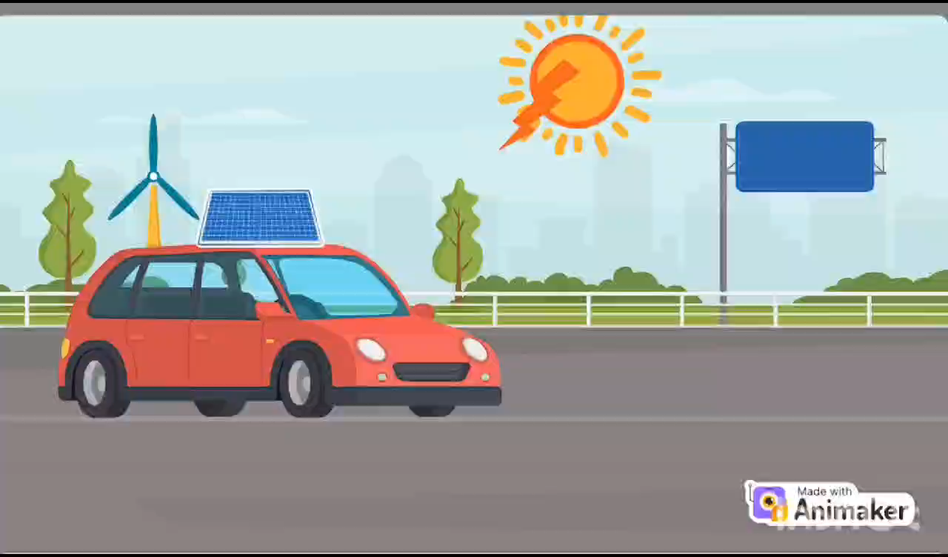

Slide 30
ANY QUERIES ?

